Slide 1

Future
of
the
Internet

Slide 2
Network
Technology/Trends/Devices
Applications
Business

Slide 3
https://www.youtube.com/watch?v=OQ9P1W_-E1U

Slide 4
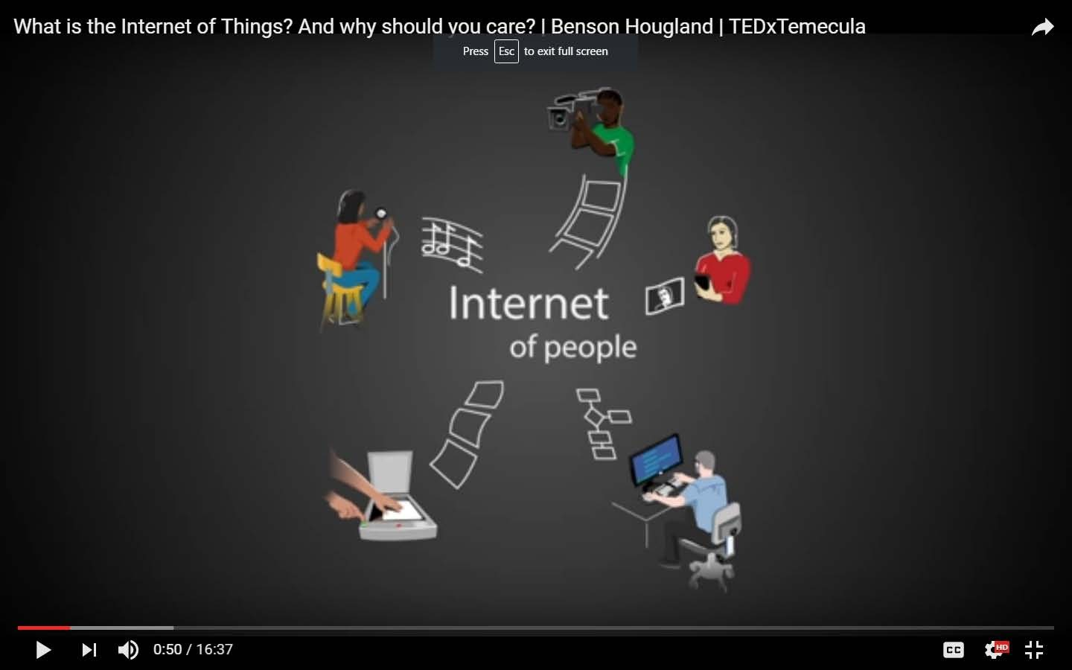

Slide 5
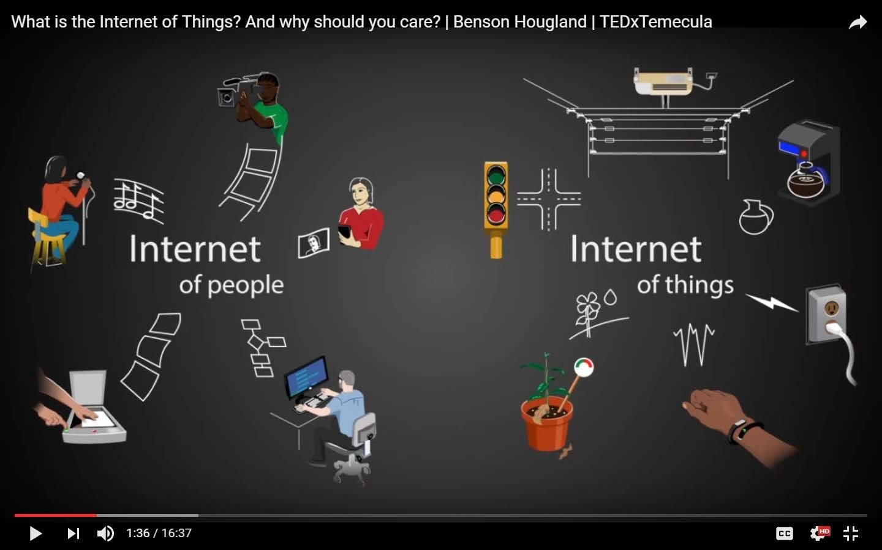

Slide 6
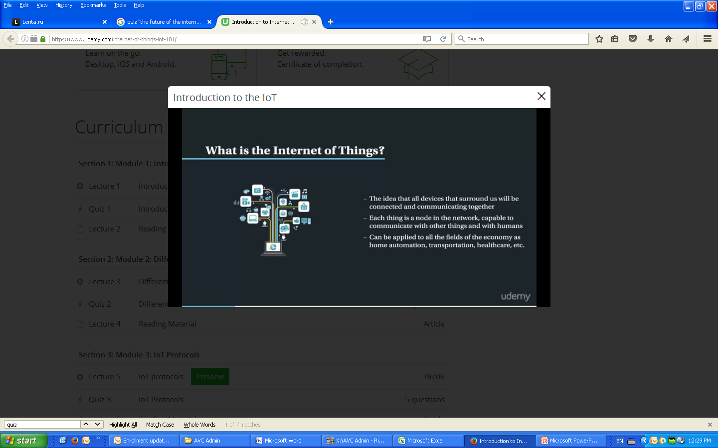

Slide 7
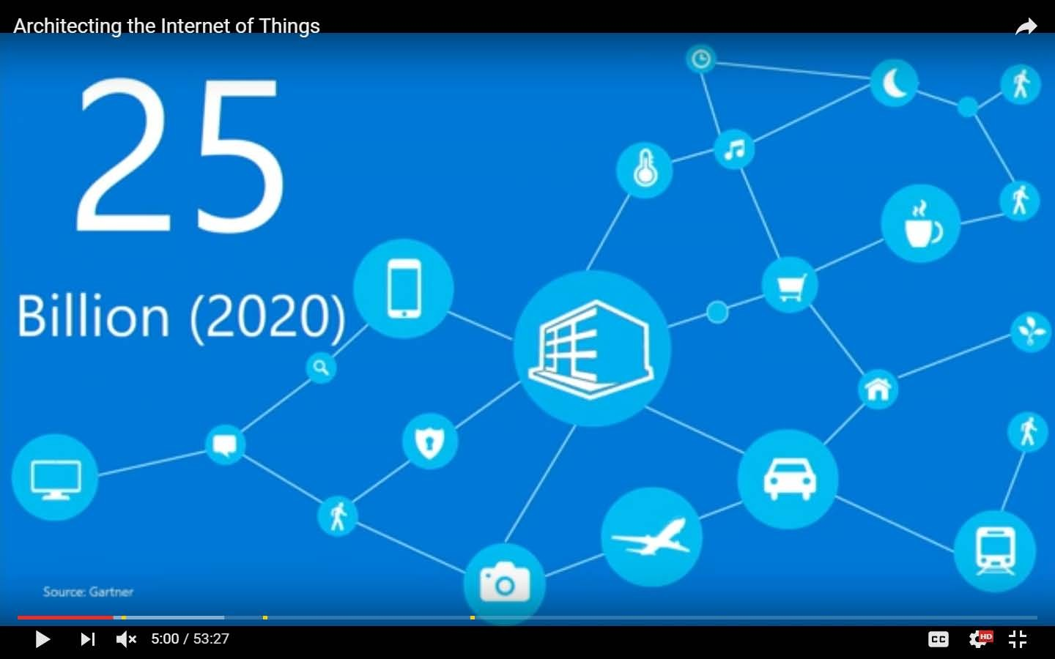

Slide 8
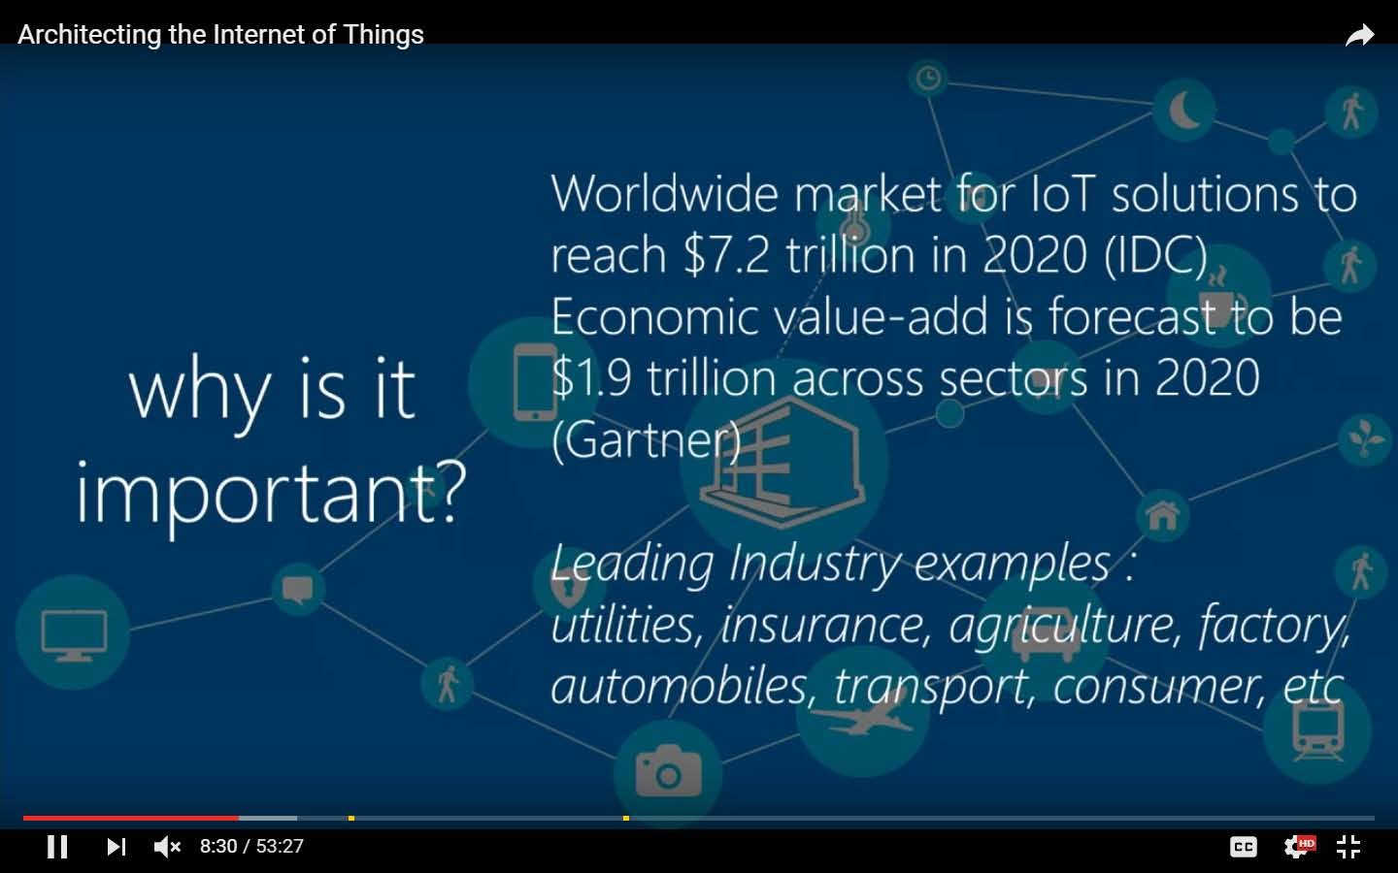

Slide 9
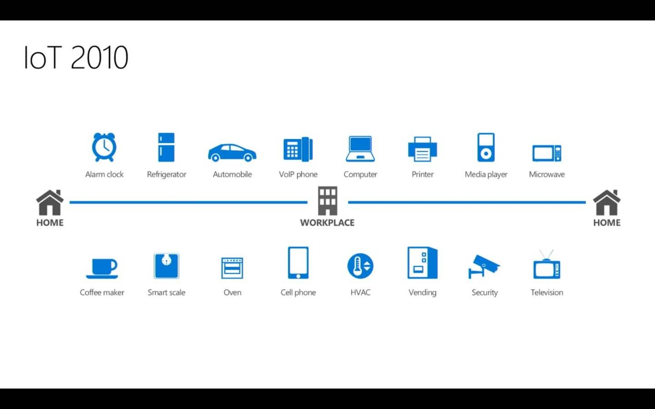

Slide 10
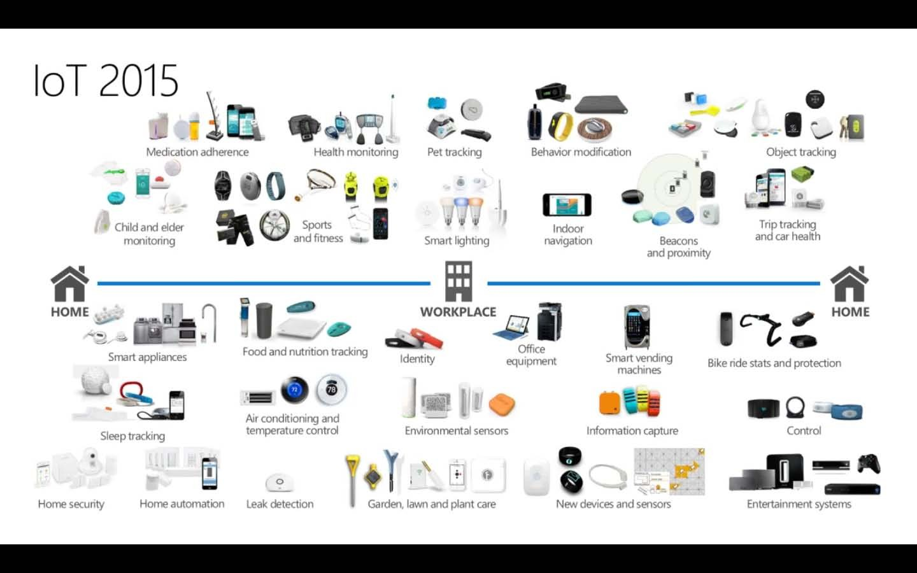

Slide 11
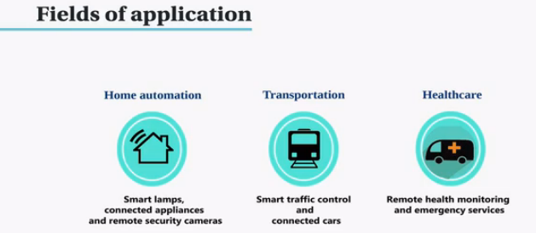
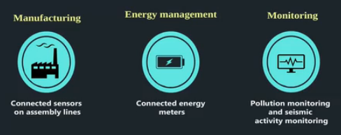

Slide 12


Slide 13
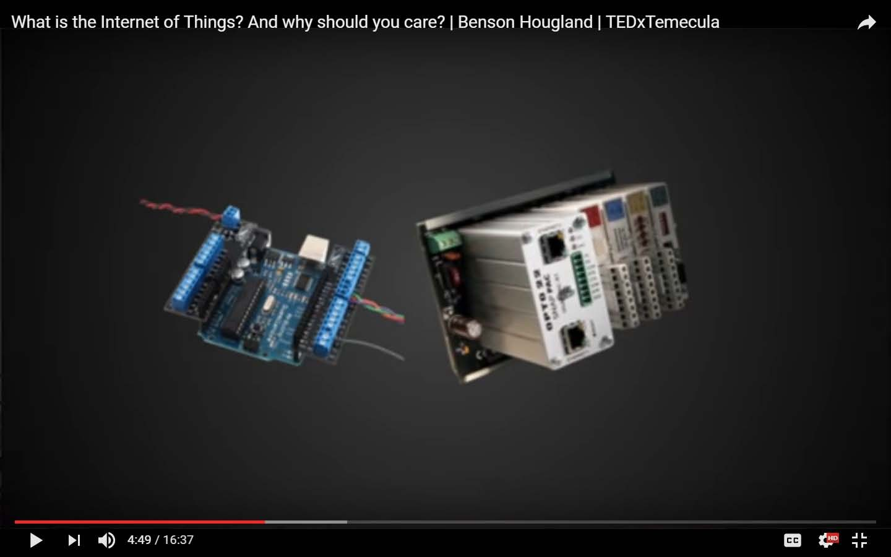

Slide 14
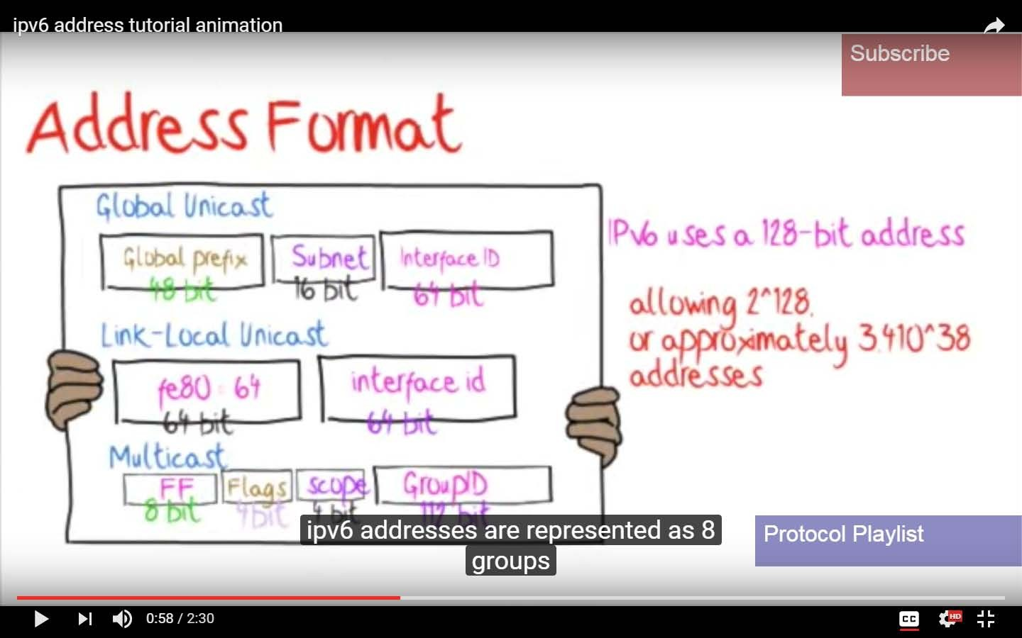
IPv6

Slide 15
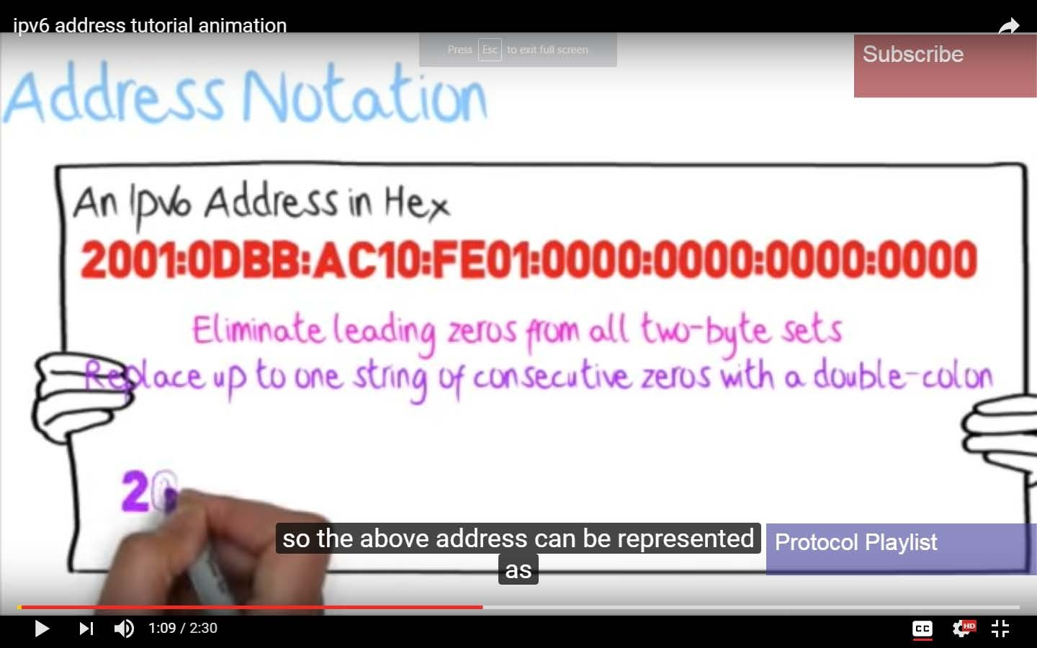

Slide 16
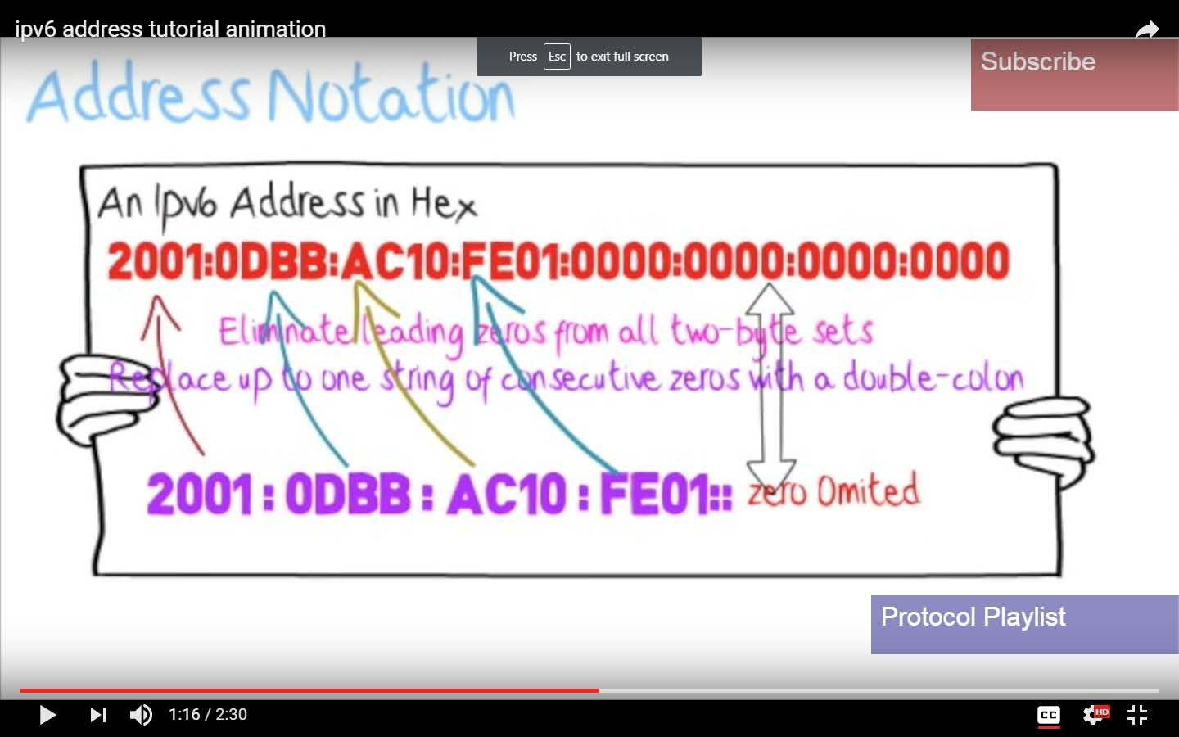

Slide 17
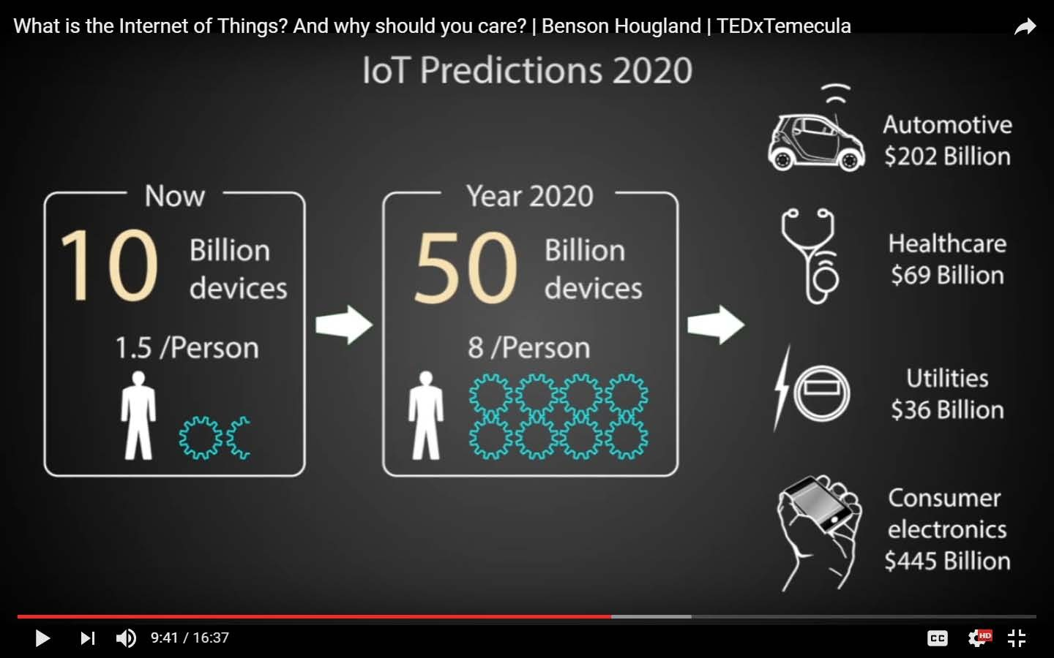

Slide 18
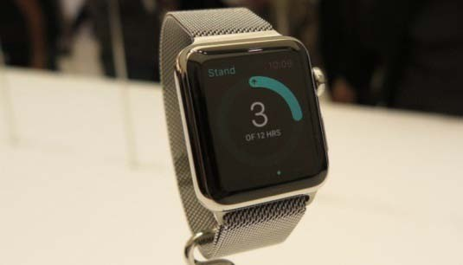
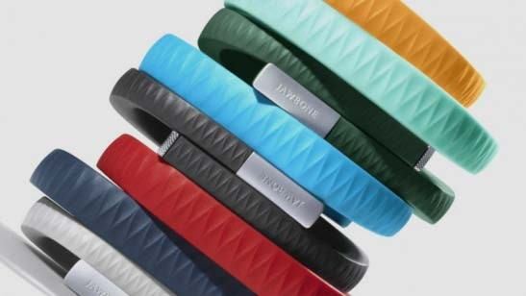
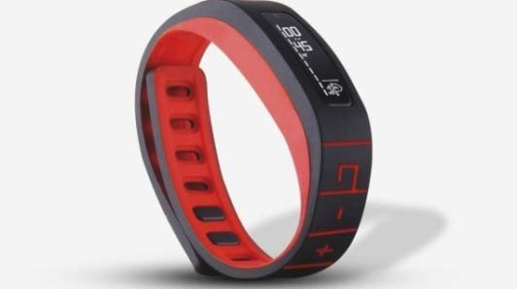
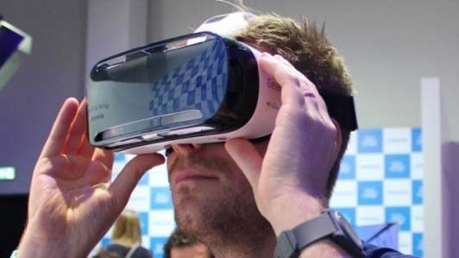
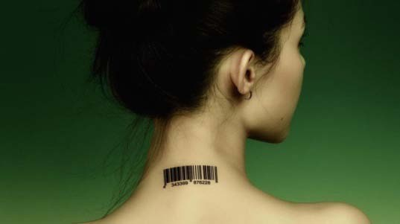
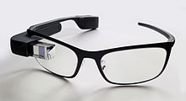
Wearables
Fitness trackers
Smart watches
Bracelets
They can record your heart rate, body fat composition, perspiration, health,
temperature and muscle activity all by just touching your skin as well as
movement, distance and speed using GPS, accelerometers and gyroscopes.
Head-mounted displays
Implantables
Google glass

Slide 19
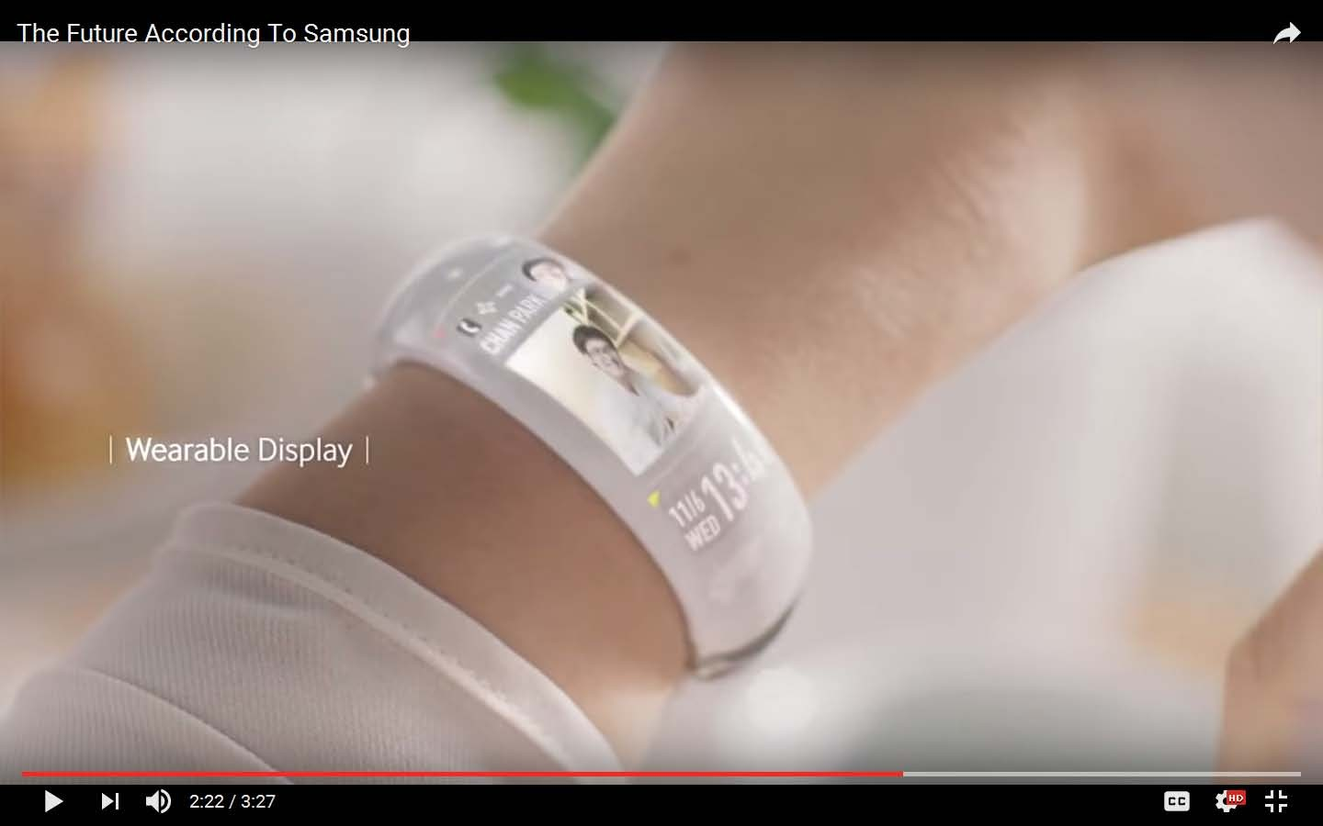

Slide 20
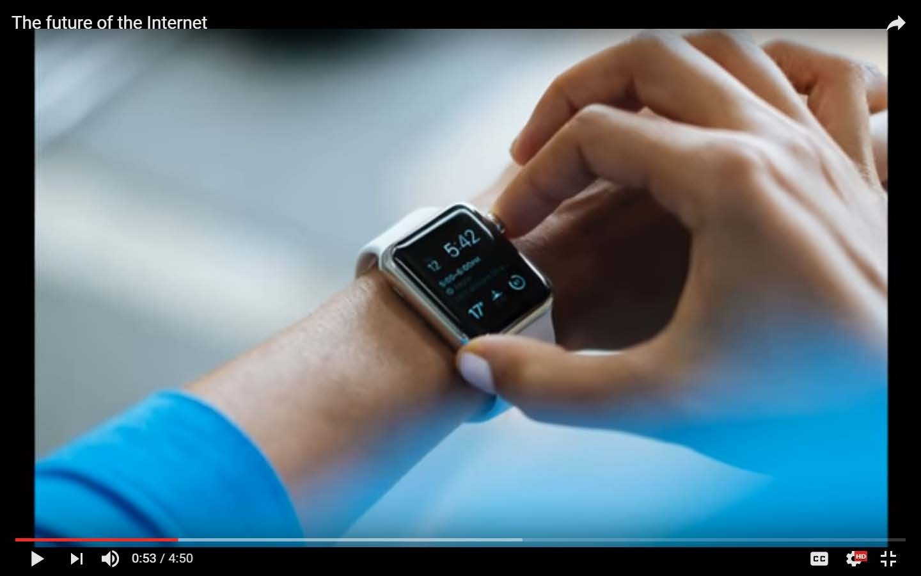

Slide 21
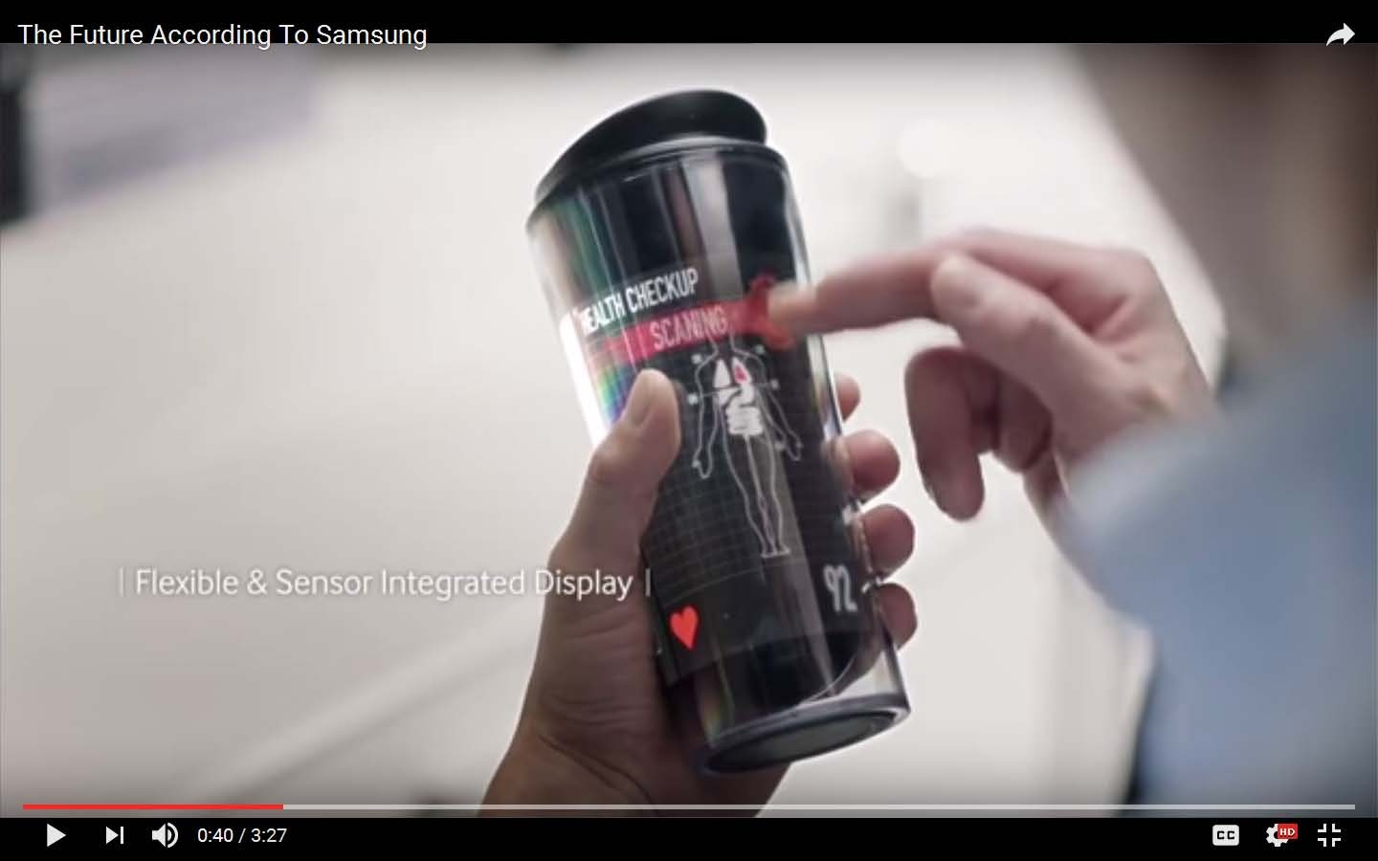

Slide 22
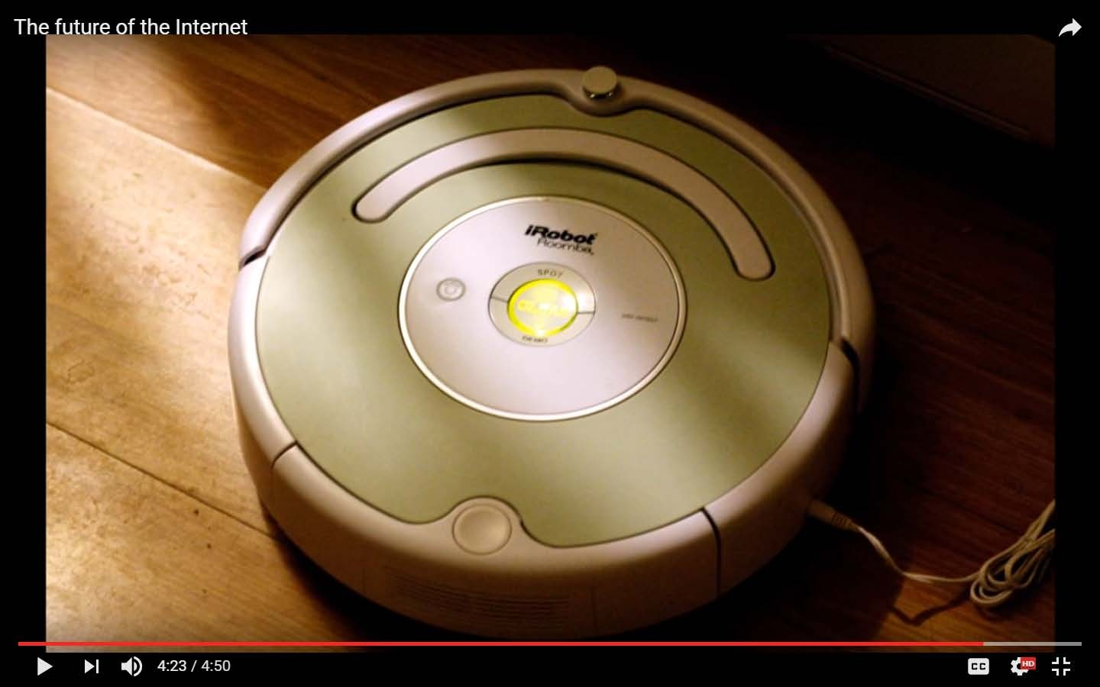

Slide 23
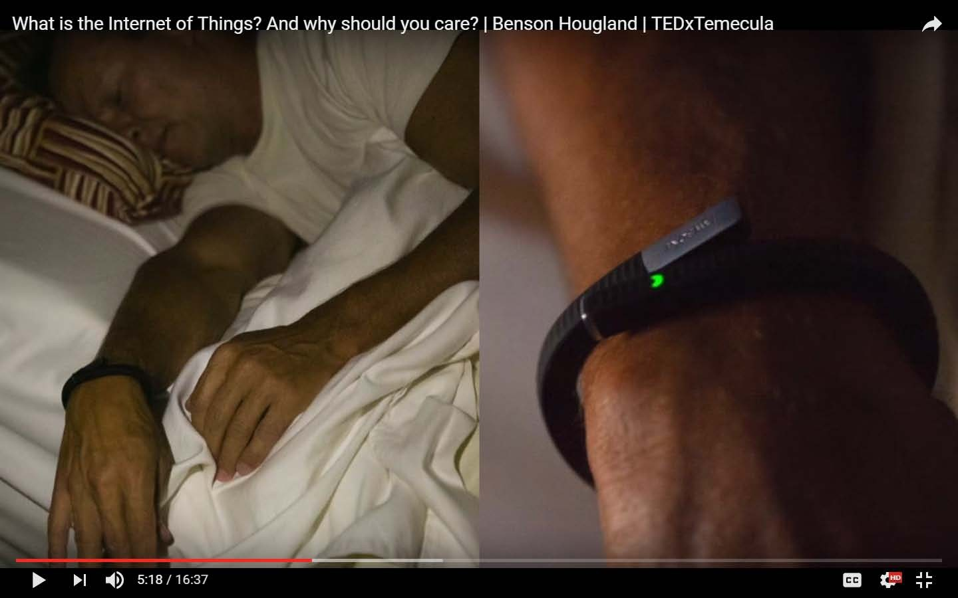

Slide 24
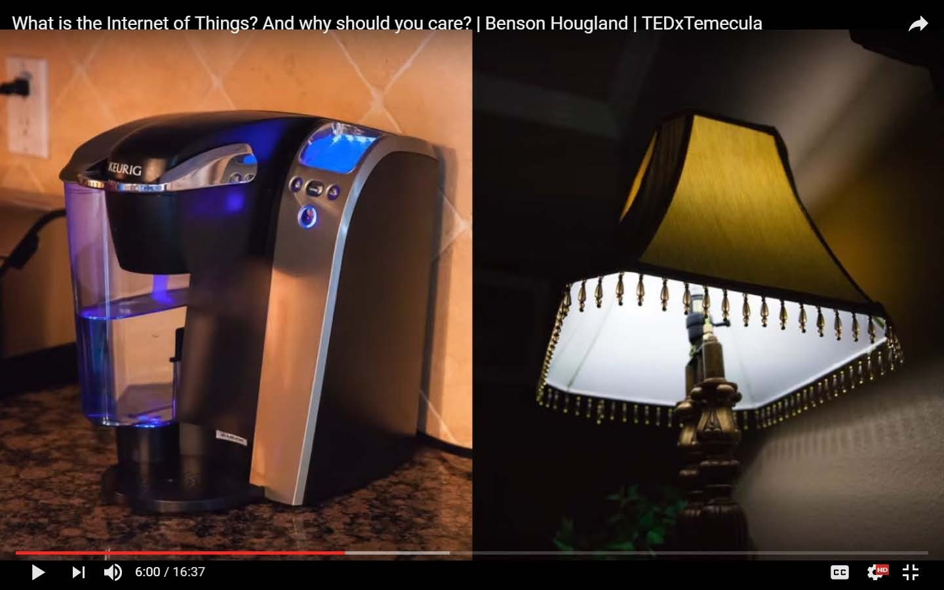

Slide 25
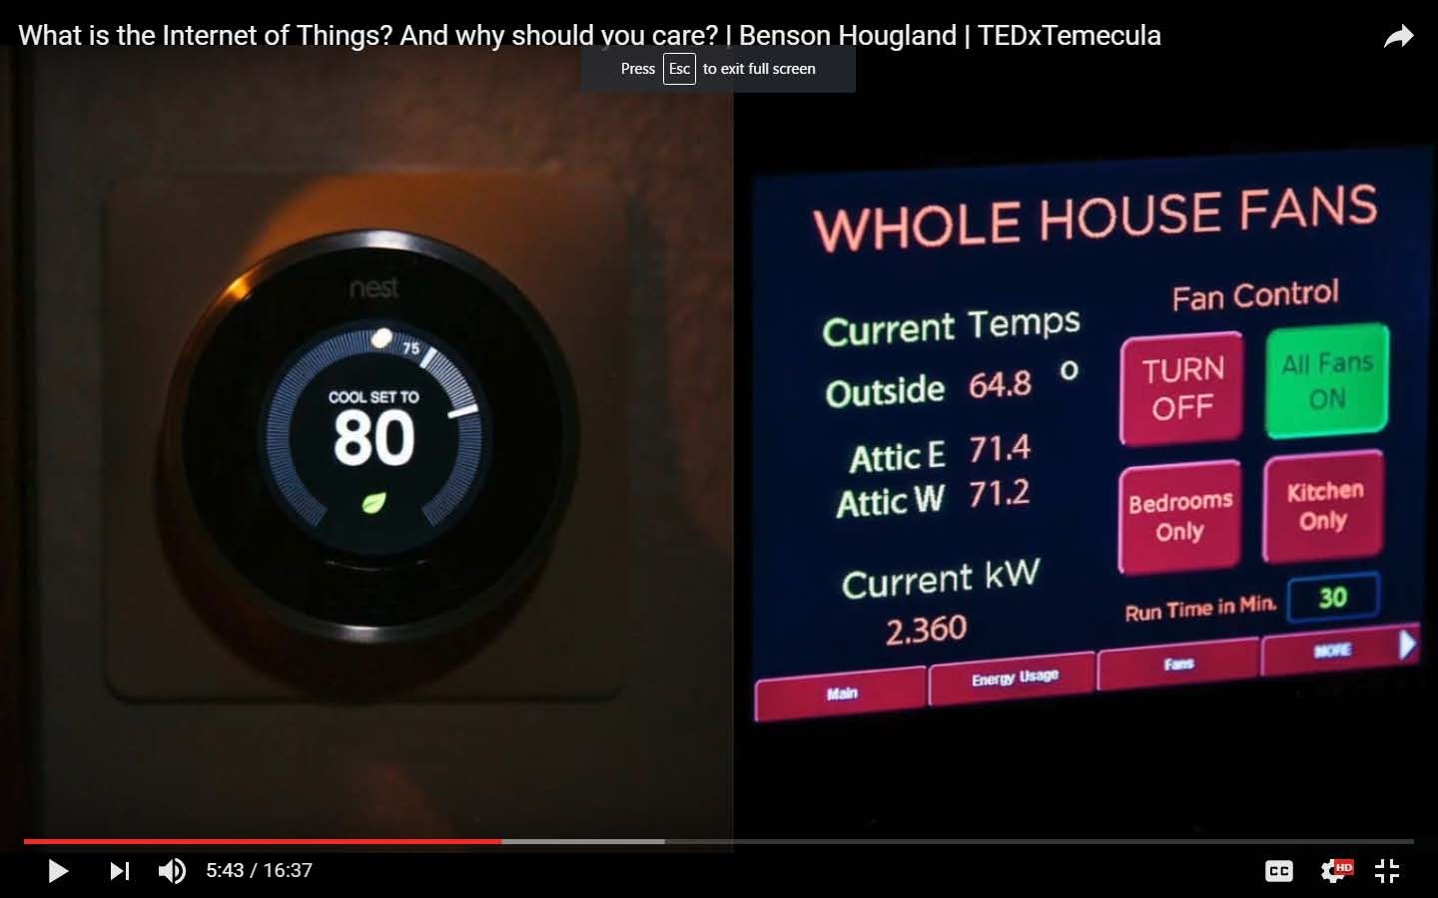

Slide 26
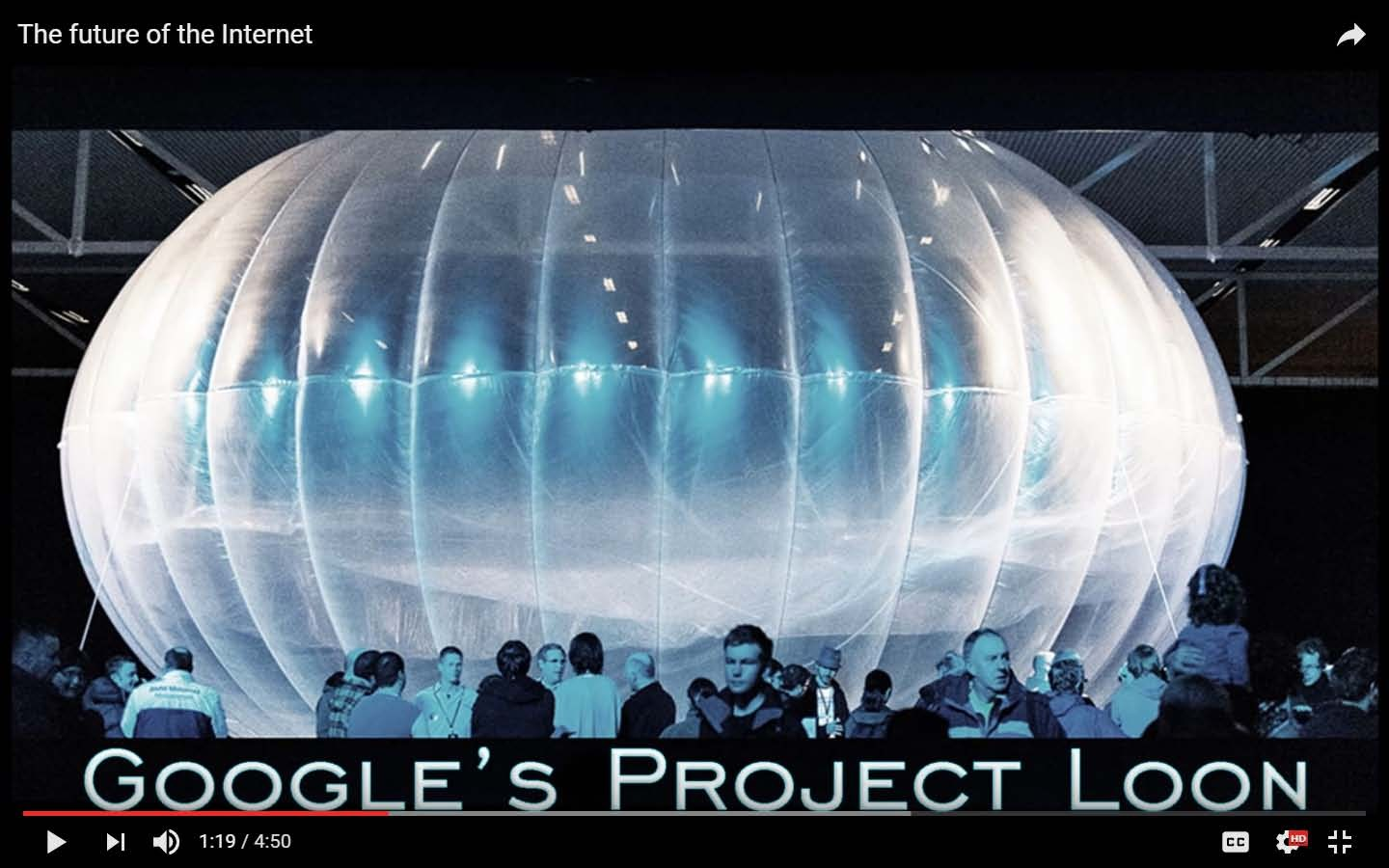

Slide 27
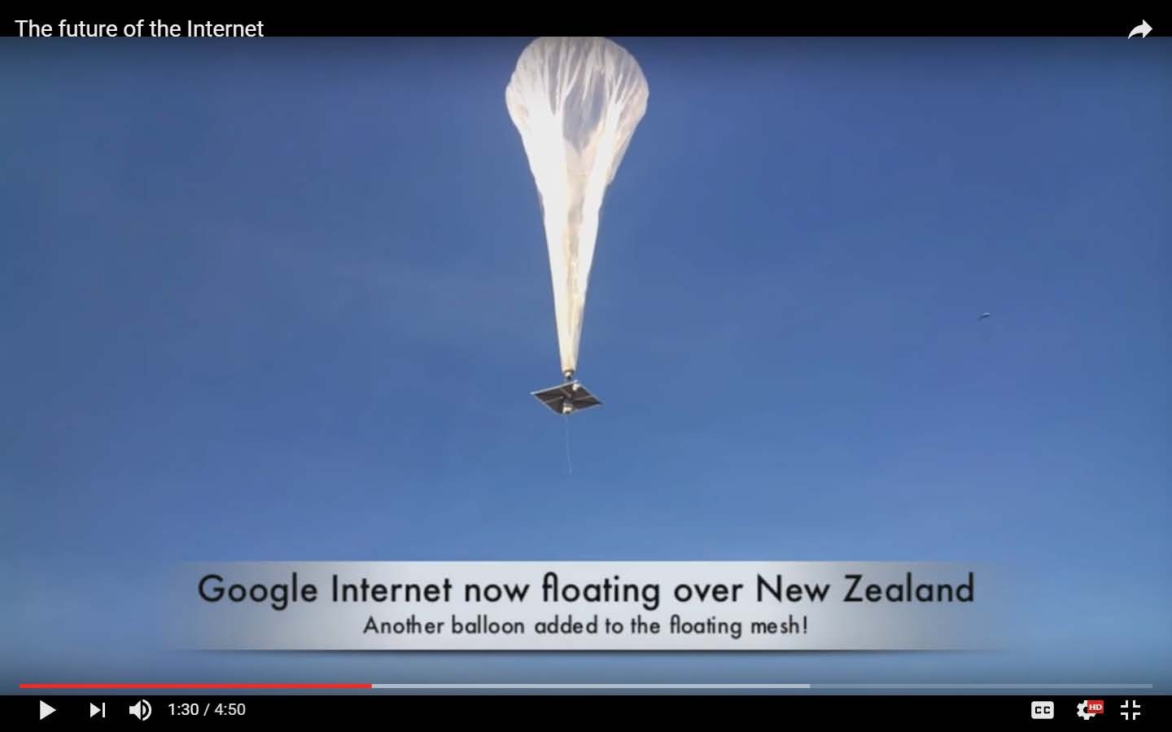

Slide 28
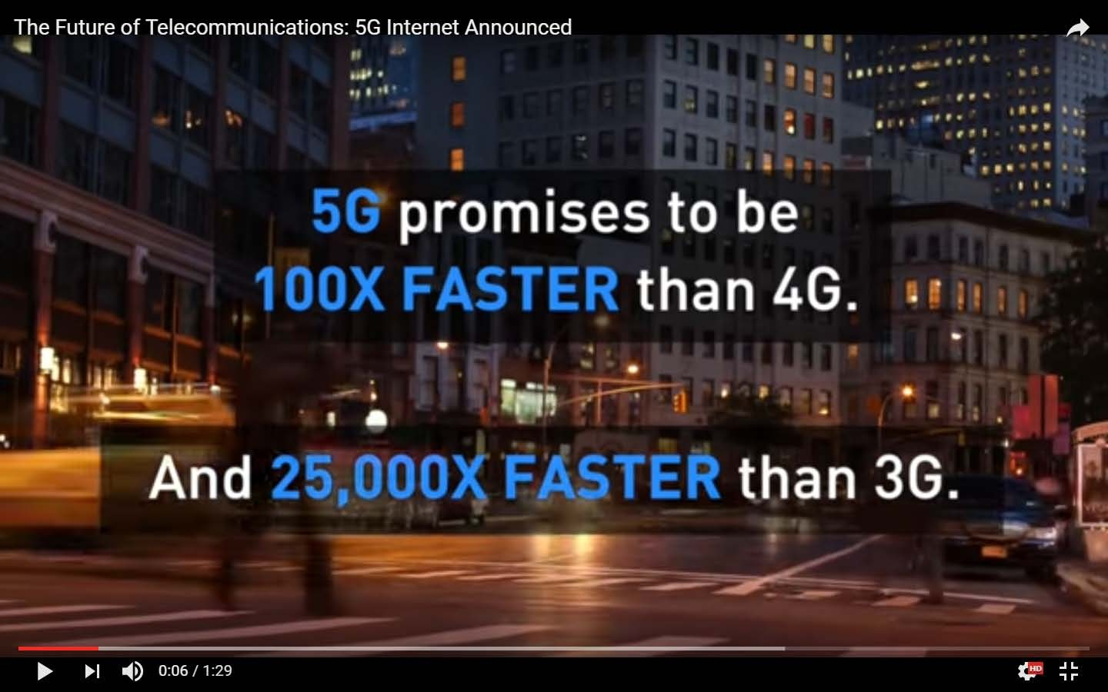

Slide 29
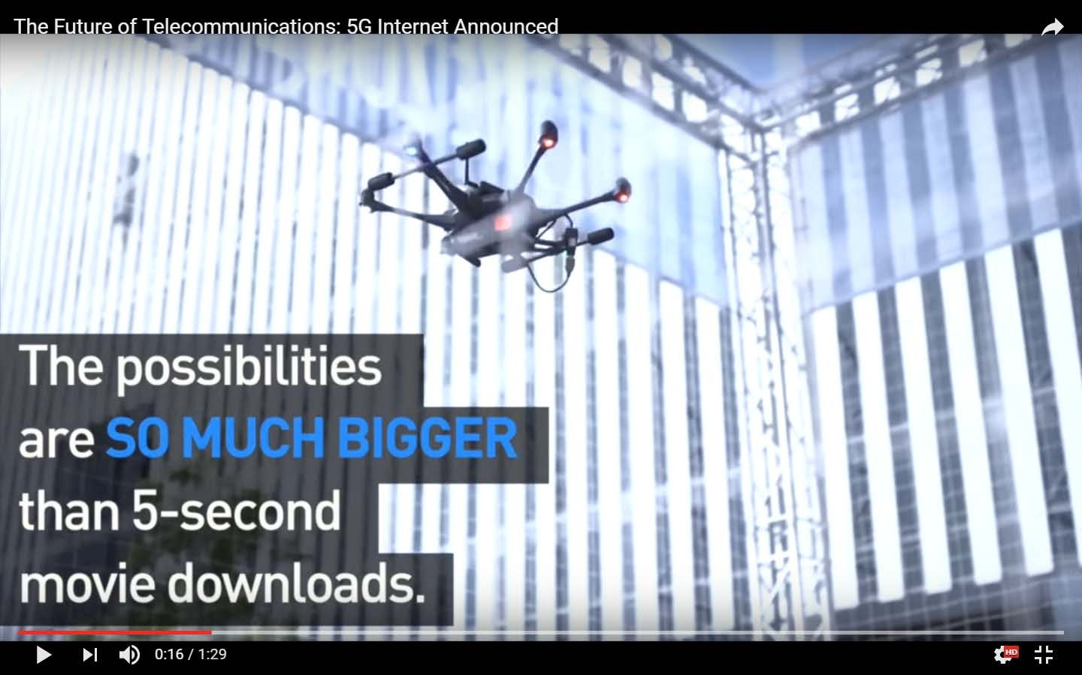

Slide 30
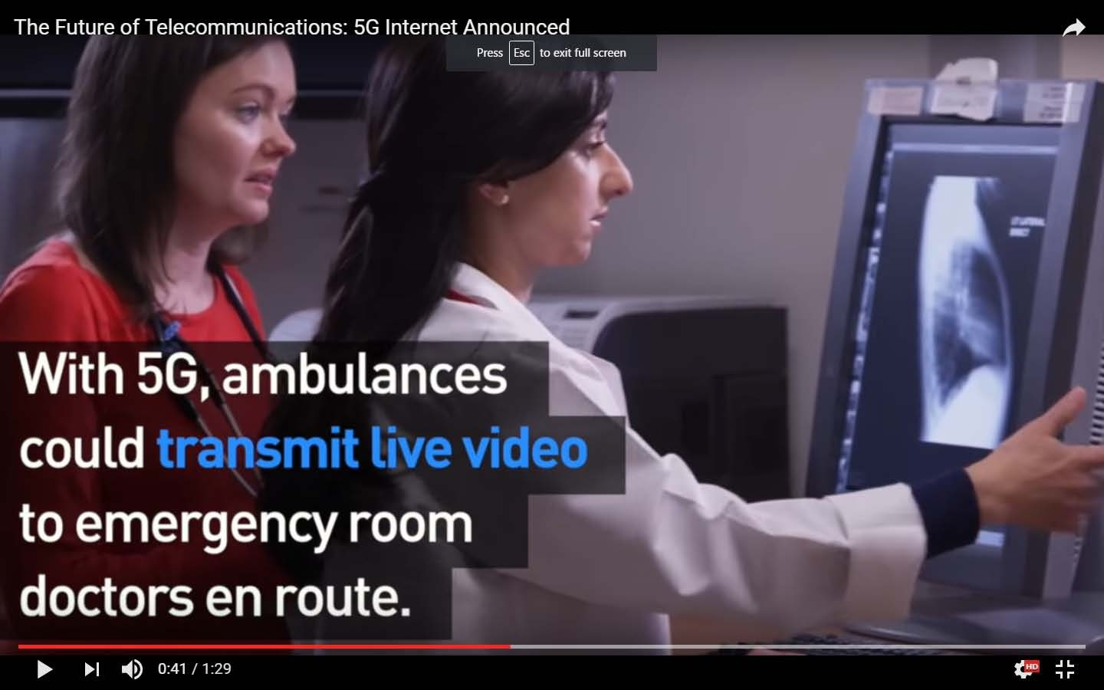

Slide 31
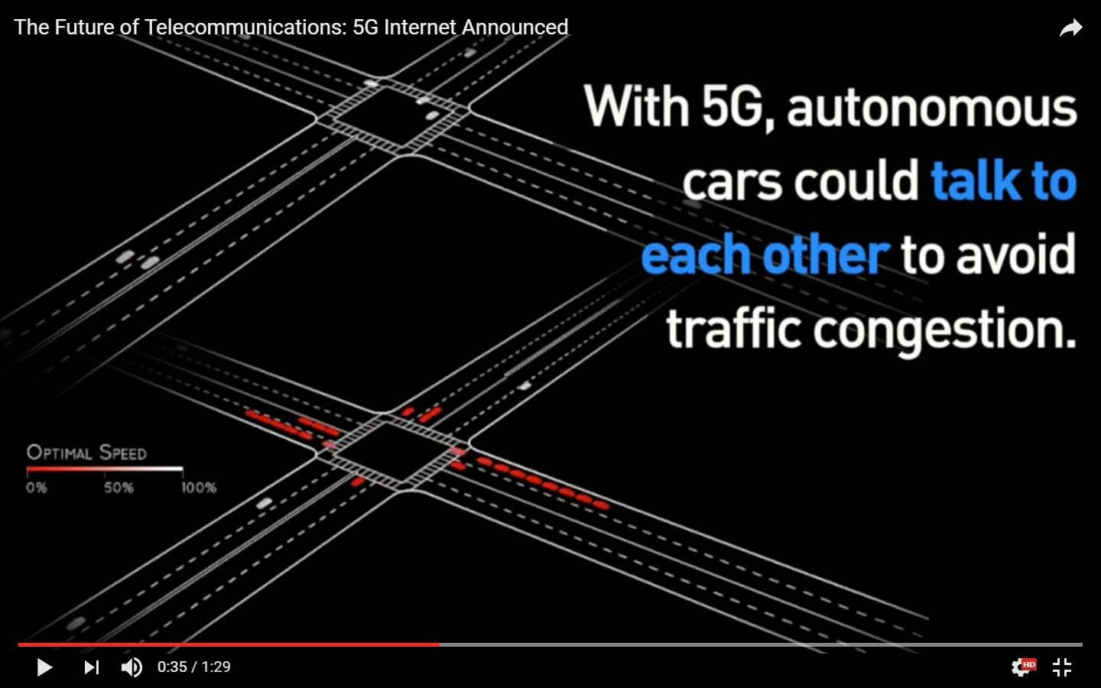

Slide 32
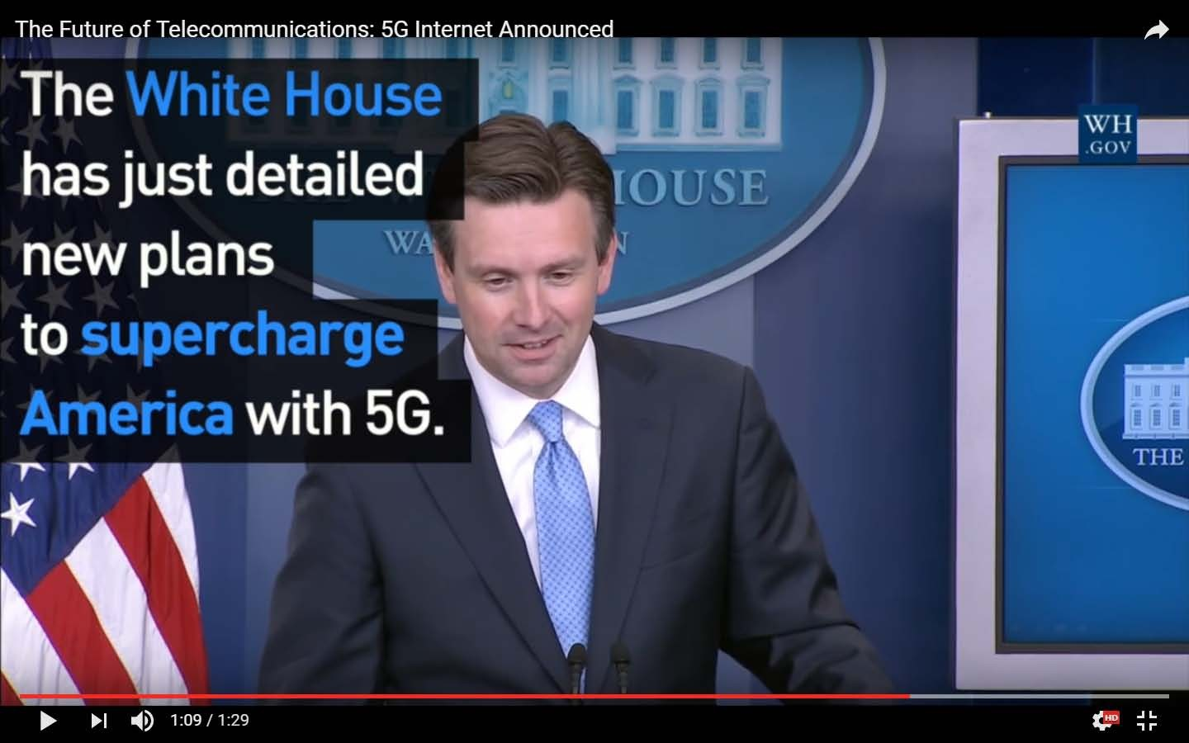

Slide 33
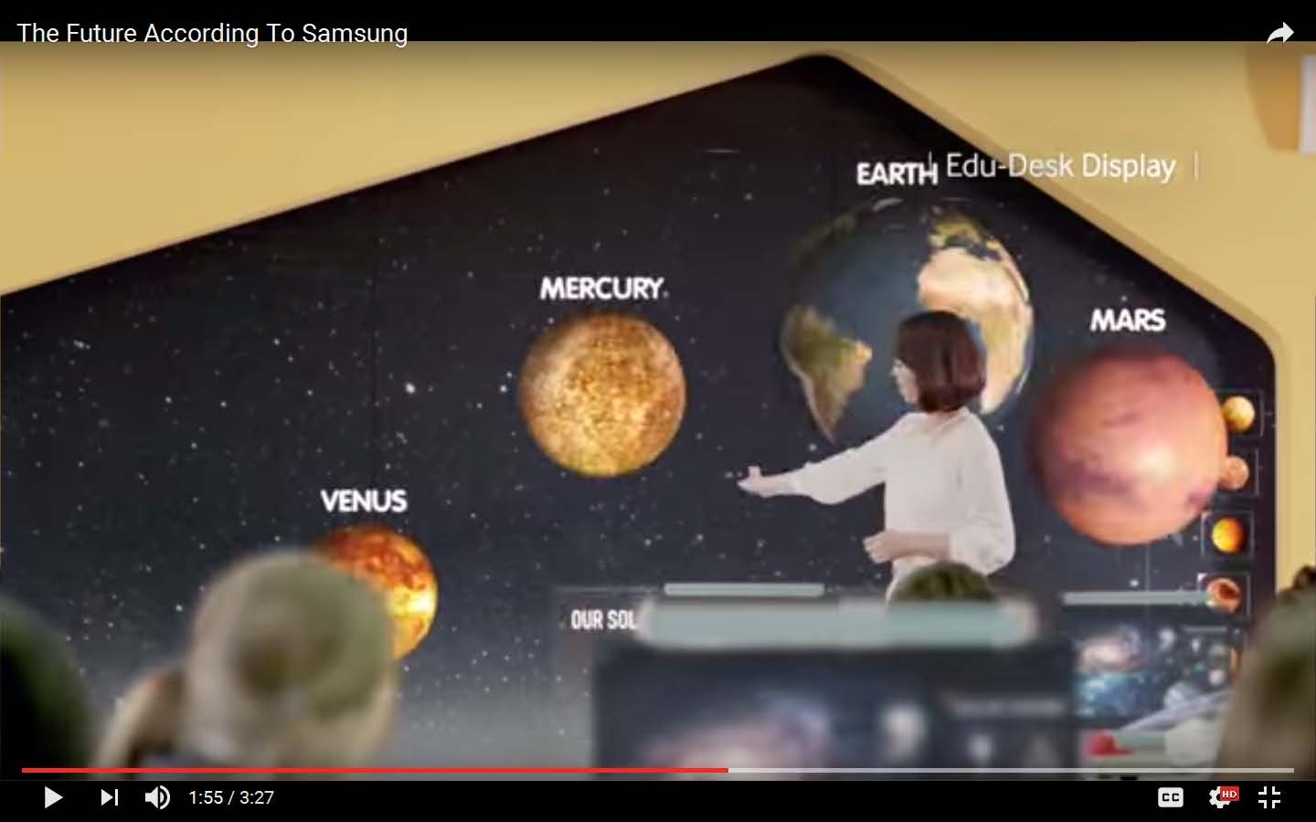

Slide 34
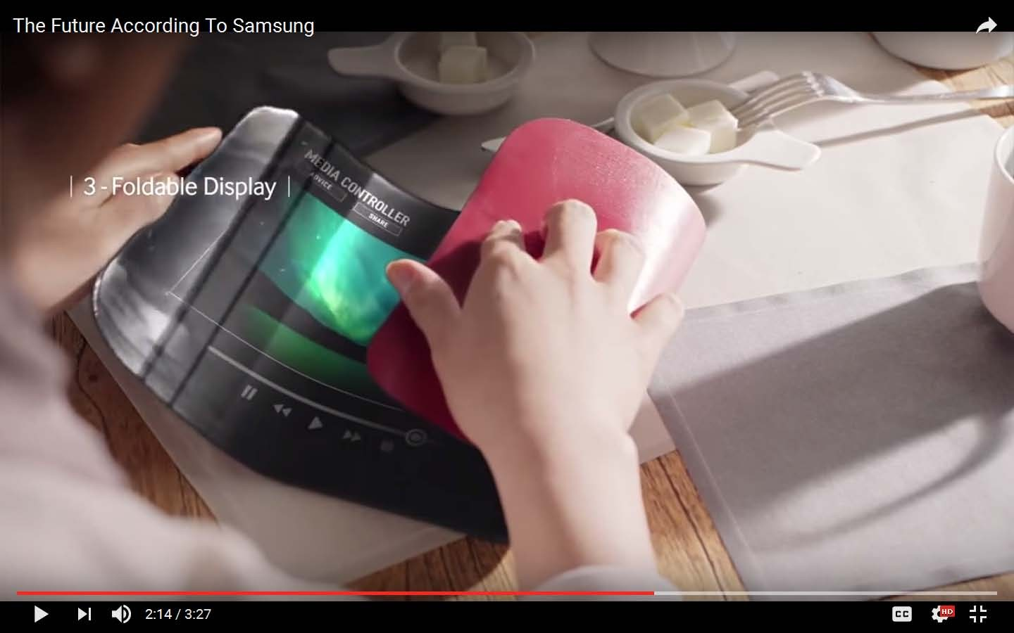

Slide 35
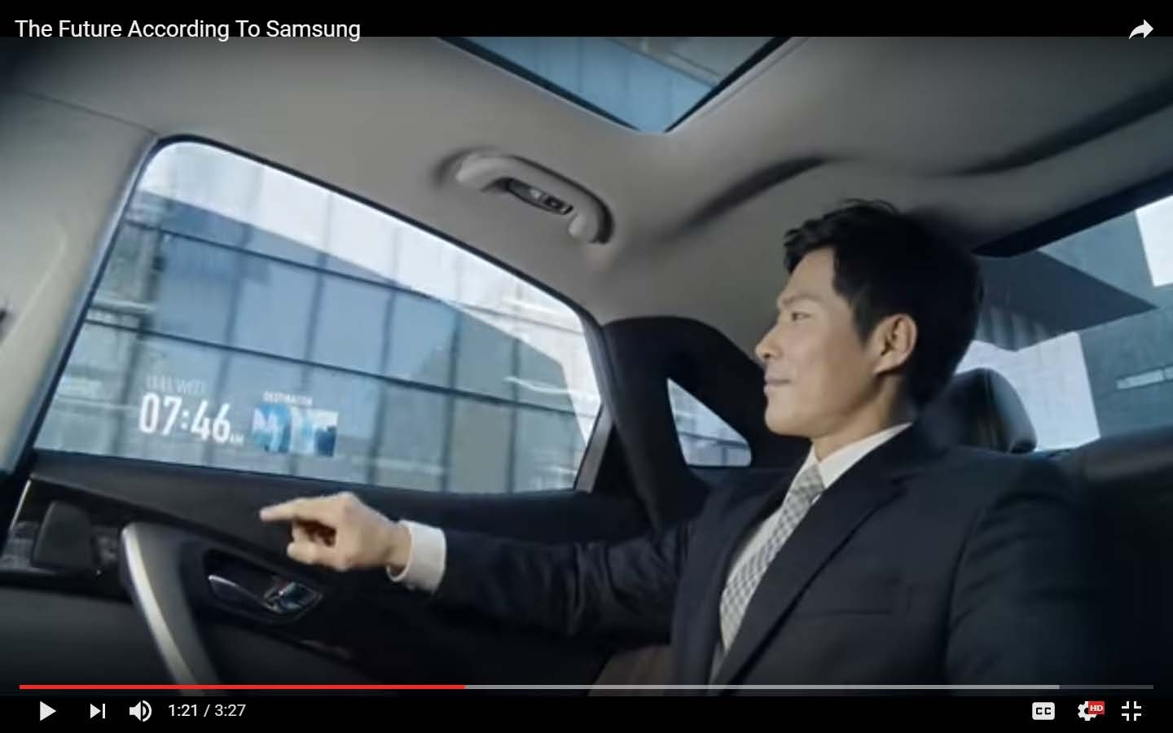

Slide 36
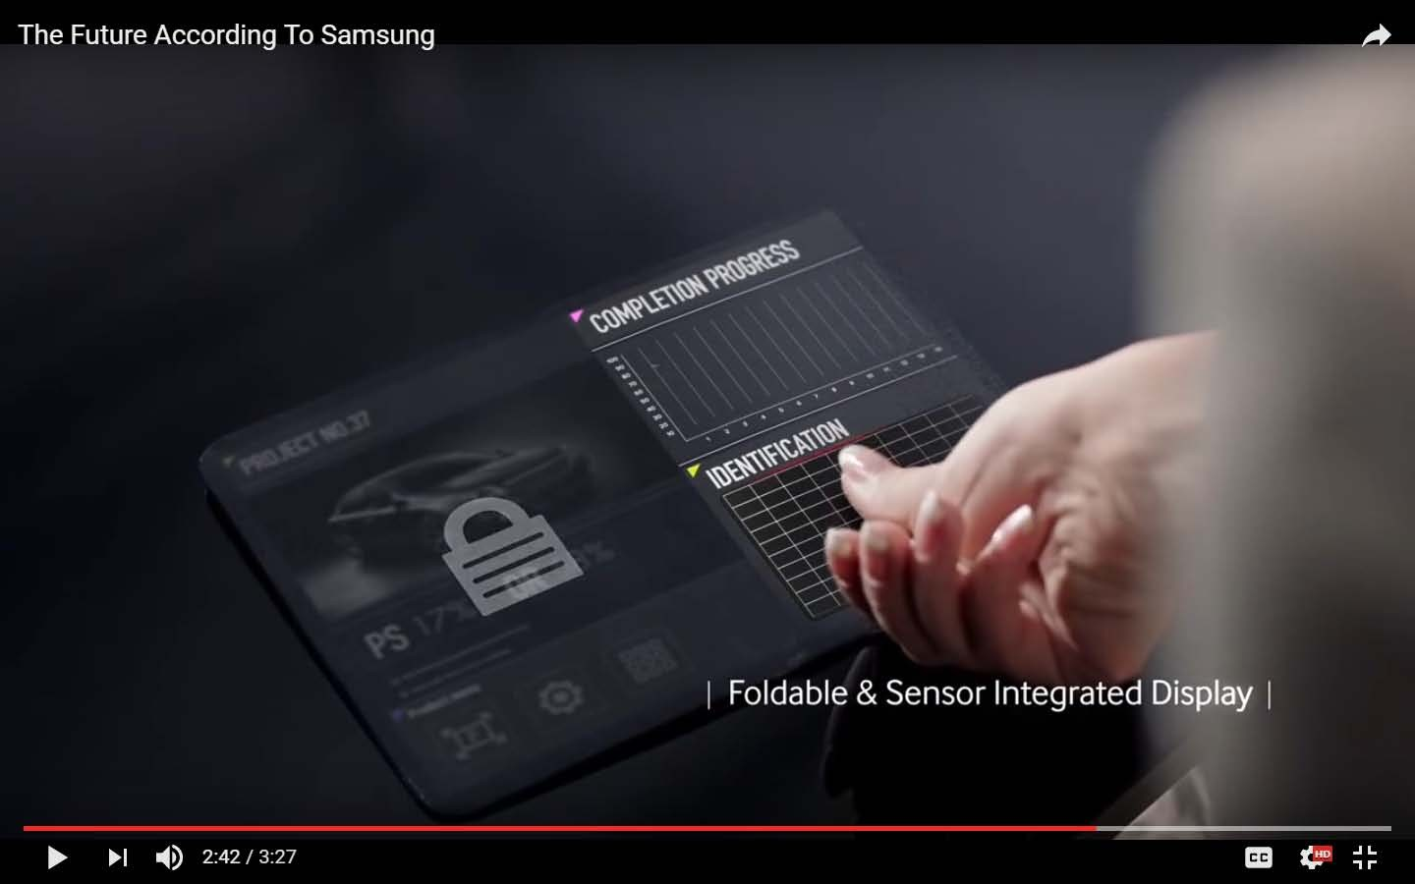

Slide 37
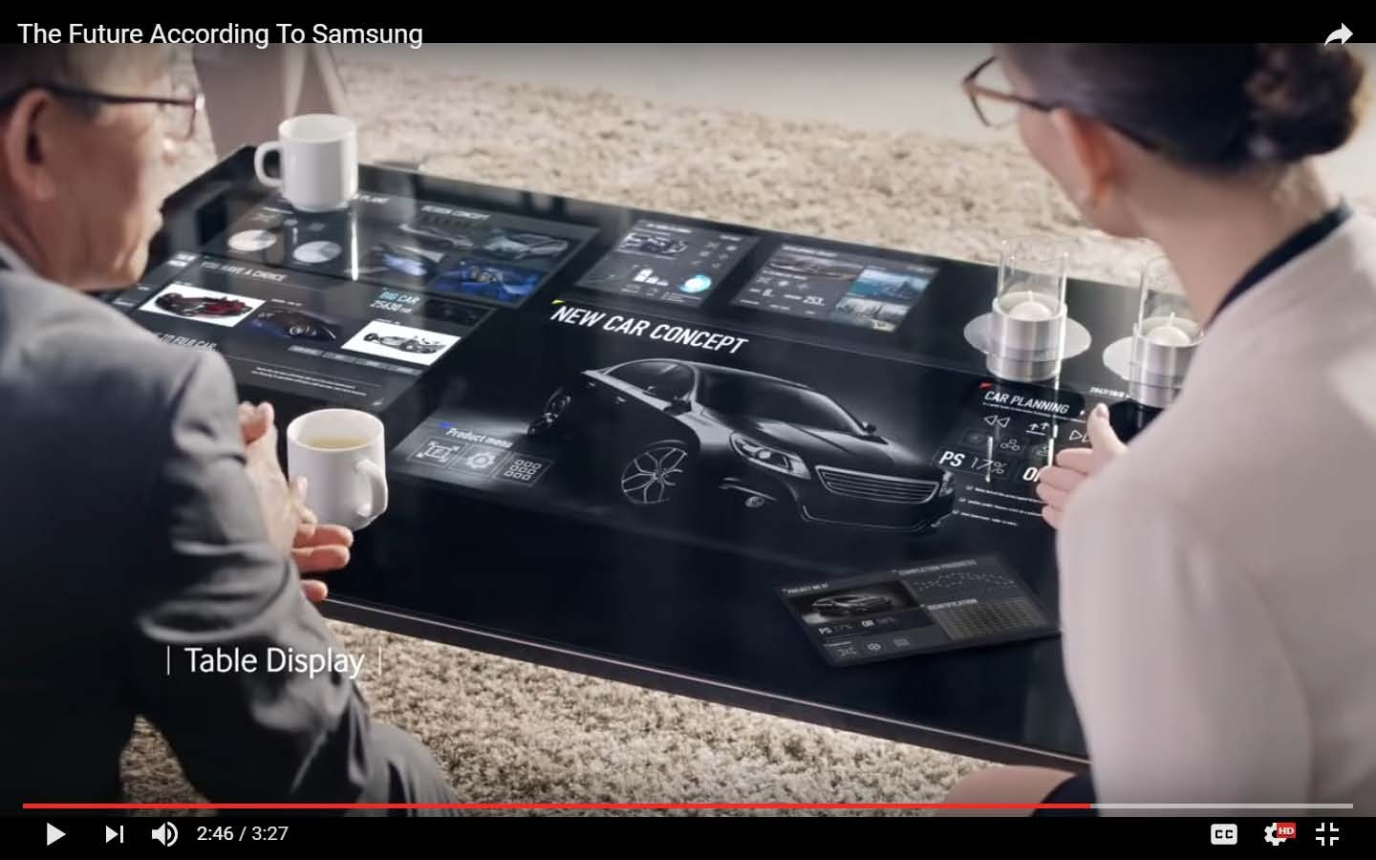

Slide 38
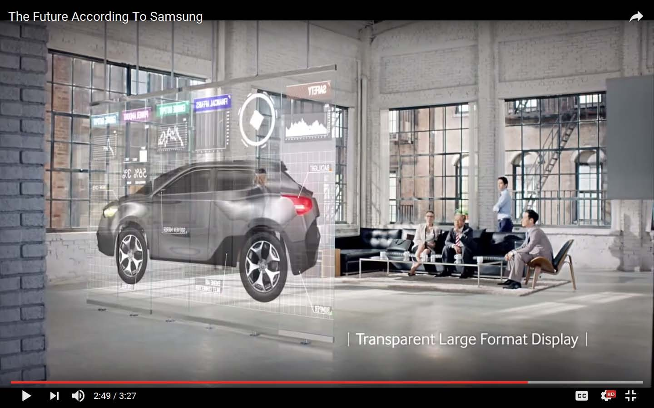

Slide 39
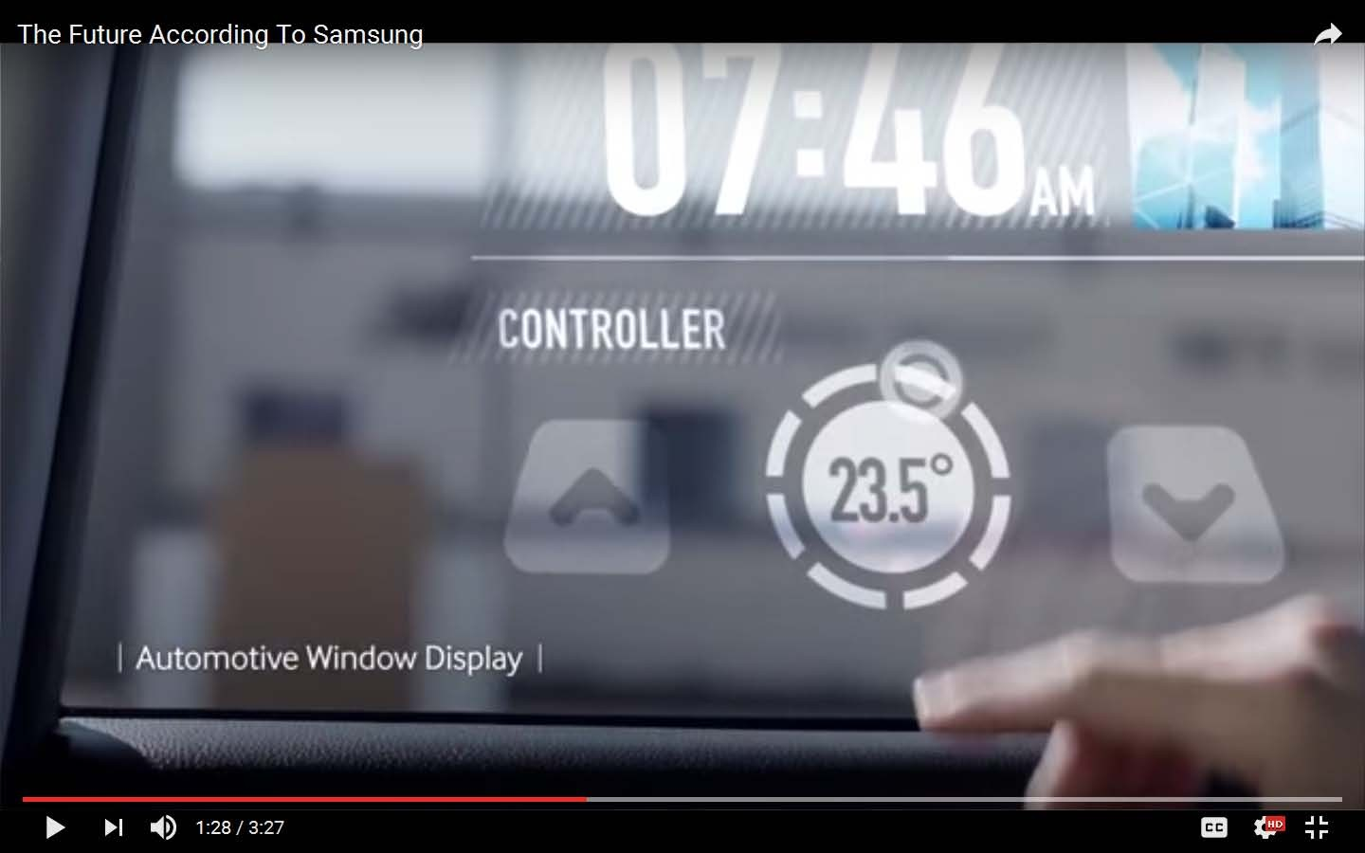

Slide 40
Smart home
http://www.youtube.com/watch?v=d9v1PVg5Xww

Slide 41
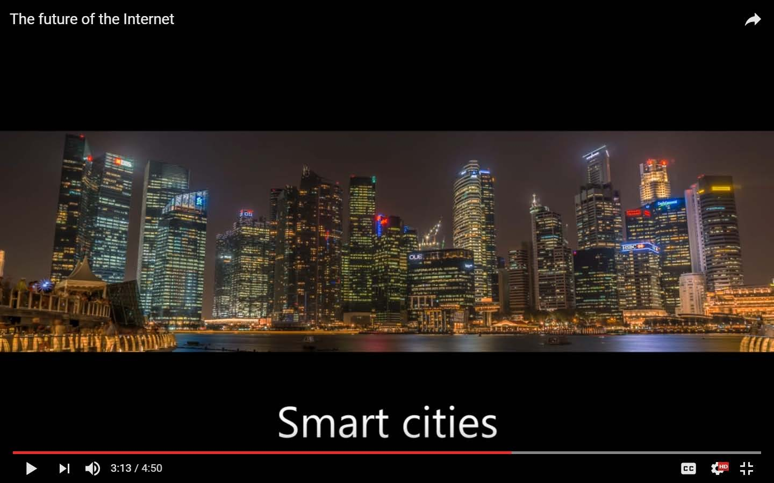

Slide 42
https://www.youtube.com/watch?v=MiowXhyZTtg

Slide 43







Over the Top (OTT) messaging services
WhatsApp, Viber, Snapchat, Telegram, Skype, Zangi,
Facebook Messenger

Slide 44

Streaming media and video
on
demand
online services
Streaming Service
Netflix
Hulu
Amazon Instant Video
Sling Orange
Playstation Vue
Crackle
Funny or Die
Twitch
Vevo
Best For
Starting Price
$9 per month
$8 per month
$99 per year or $7.99 per month
$20 per month
$50 per month
Free Free Free Free
Overall
Network TV
Families
Cable TV Replacement
Playstation Owner
Vegging Out
Comedy Fans
Gamers
Music Fans

Slide 45
New applications
What is Instagram?
Instagram is a popular photo-sharing app for smartphones. Compared with
other social networks, Instagram is relatively simple—it's focused exclusively
on sharing photos with your friends.
Why use Instagram?
At this point, you may be thinking: Why do I need a separate app for sharing
photos? Couldn't I just post them on Facebook or another social network?
One reason for Instagram's popularity is its simplicity. Rather than focusing
on a lot of different features, Instagram has only one core feature, which
makes it especially easy to share photos and see photos from your friends.

Slide 46
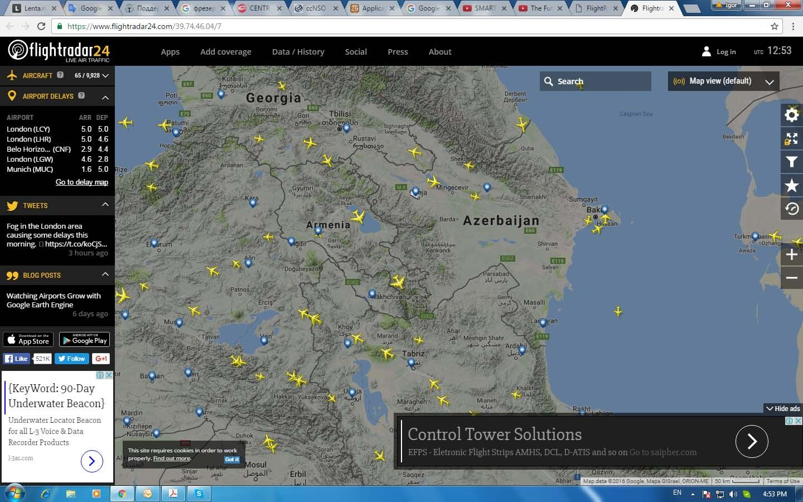

Slide 47
https://www.flightradar24.com

Slide 48
Cloud computing
https://www.youtube.com/watch?v=ae_DKNwK_ms

Slide 49
On-line learning
MIT courses
Eliademy
Coursera on-line courses
Udacity on-line courses
Virtual University- Web Design and Programming Courses
Virtual University- Technology Courses
RIPE NCC: Learn on-line videos (IPv6, DNSSEC, RIPE Database, RIPE Community)
Microsoft Virtual Academy
Codeacademy
Networking Video Lectures/Tutorials
Other resources

Slide 50
Quiz
Can you name 3 fields of IoT application?
Can you bring some examples of wearable devices?
What means of Internet coverage is proposed by Google?
What is IPv6?
Can you name 3 examples of OTT applications?
What type of computing can save the money of your business?

